Slide 1
Disk Management

Slide 2
Disk Management
The Operating System is responsible for several other aspects of disk management activities as well:
Disk Formatting
Disk Initialization
Booting from Disk
Bad Block Recovery

Slide 3
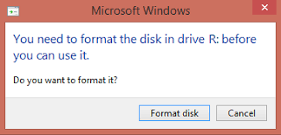
Disk Formatting
A new magnetic disk is a blank slate
Just a platter of a magnetic recording material
Before a disk can store data, it must be divided into sectors
This process is known as low-level formatting OR physical formatting
Low-level formatting fills the disk with a special data structure for each sector
Contains a header and a trailer
Header and Trailer contents are used by disk controller
Contents are: Sector Number and an Error-Correcting Code
Notes:
When the controller writes a sector of data during normal IO operation, the ECC is updated with the value calculated from all the bytes in the data area. When the sector is read, the ECC is recalculated and compared with the data. If the stored and calculated numbers are different, this indicates that the data area of the sector has been corrupted and the disk sector may be bad.

Slide 4
Disk Formatting
Recoverable Error - Soft Error
Most hard disks are low-level formatted at the factory
Sector size of 512 bytes are common in OS
Before storing files, the OS will need to record it’s own data structures
Two Steps:
Partitioning the Disk
Logical Formatting (Creation of File System – FAT, inodes)

Slide 5
Boot Block
For a computer to start running, it must have an initial program to run.
This initial bootstrap program all aspects of the system
From CPU registers to device controllers, contents of main memory, starting of operating system, etc.
To do its job, the bootstrap program finds the OS Kernel on disk, loads the kernel into the memory.
For most computers, bootstrap is stored in ROM
Boot Block: Blocks where the full bootstrap program is stored in the disk
A disk that has a boot partition is called a boot disk or system disk

Slide 6
Bad Blocks
Disks are prone to failure
If blocks go bad during normal operation, then some special programs (such as chkdsk) must be run manually to search for bad blocks
Data that resided on the bad blocks are typically lost
The disk controller can be told to replace each bad sector logically with one of the spare sectors

Slide 7
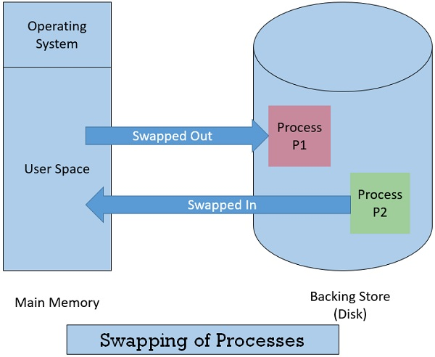
Swap-Space Management
It is a technique of removing a process from main memory and storing it into secondary memory, and then bringing it back into main memory for continued execution.
Moving a process out from main memory to secondary memory is called Swap Out
Moving a process out from secondary memory to main memory is called Swap In.

Slide 8
Swap-Space Management
Swap-Space management is another low-level task of the operating system.
The goal of this swap-space implementation is to provide the best throughput
Swap-space is used in various ways by different OS – based on the memory management algorithms
The amount of swap-space will vary from a few megabytes to gigabytes based on the amount of physical memory

Slide 9
Disk Reliability
Reliability is the ability of the disk system to accommodate a single or multi-disk failure and still remain available to the users.
Performance is the ability of the disks to efficiently provide information to the users.
Adding redundancy almost always increases the reliability of the disk system
The most common way to add redundancy is to implement a Redundant Array of Inexpensive Disks (RAID).

Slide 10
RAID
RAID or redundant array of independent disks is a data storage virtualization technology that combines multiple physical disk drive components into one or more logical units for data redundancy, performance improvement, or both.
It is a way of storing the same data in different places on multiple hard disks or solid-state drives to protect data in the case of a drive failure.
A RAID system consists of two or more drives working in parallel.

Slide 11
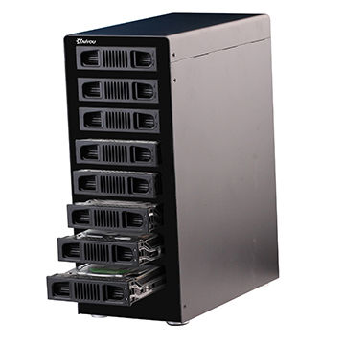
Disk Reliability – Why Redundancy?
Although taking up extra space, adds to disk reliability
In case of disk failure, if the same data is also backed up onto another disk, we can retrieve the data and go on with the operation

Slide 12
Disk Reliability – RAID Levels
RAID 0 (Striping)
RAID 1 (Mirroring)
RAID 2 (Parity Bit)
RAID 3 (Bit-interleaved Parity)
RAID 4 (Block-interleaved Parity)
RAID 5 (Block-interleaved Distributed Parity)
RAID 6 (P + Q Redundancy)

Slide 13
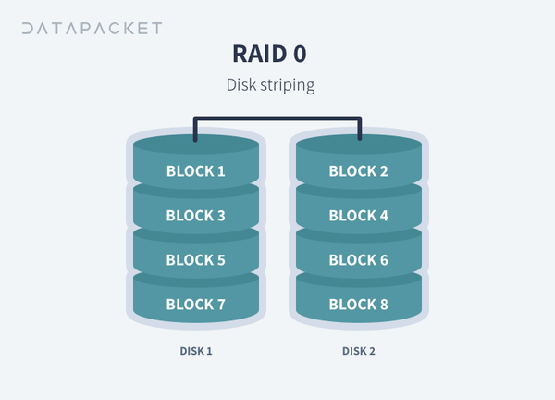
RAID 0 - Striping
Minimum number of disks: 2
Pros: Increased performance (Write and read speeds).
Cons: No redundancy.

Slide 14
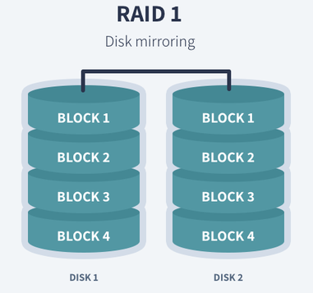
RAID 1 - Mirroring
Minimum number of disks: 2
Pros:
Fault tolerance and easy data recovery.
Increased read performance.
Cons:
Lower usable capacity.
Higher cost per bit
Business use: Standard application servers where data redundancy and availability is important.

Slide 15
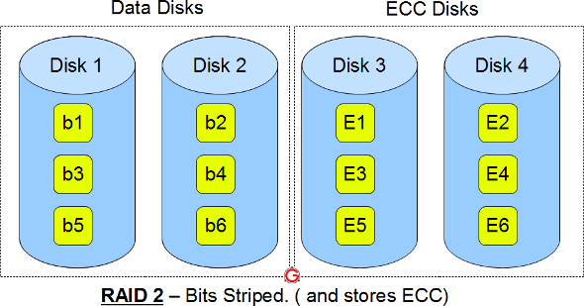
RAID 2- Error Correcting Codes (ECC)

Slide 16
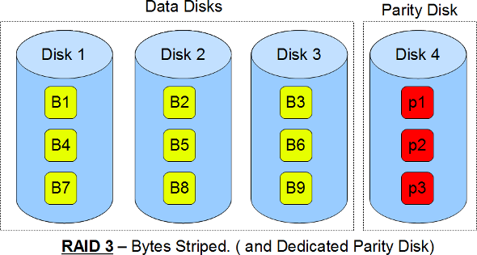
RAID 3 – Bit Interleaved Parity

Slide 17
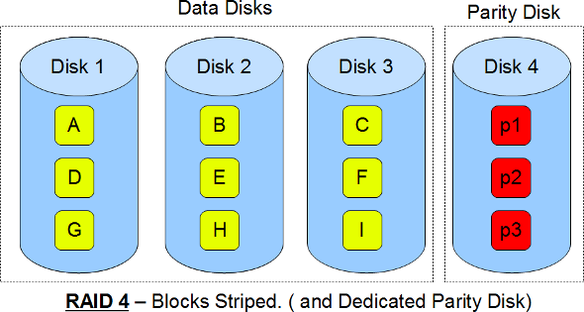
RAID 4 – Blocks Interleaved Parity

Slide 18
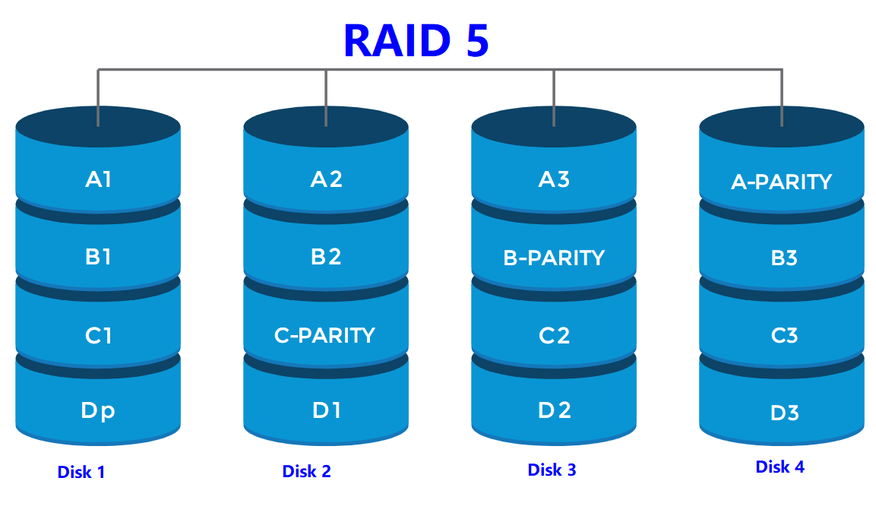
RAID 5 – Block Interleaved Distributed Parity

Slide 19
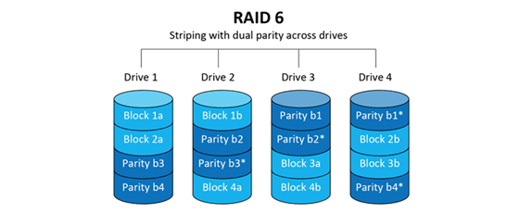
RAID 6 – P+Q Redundancy

Slide 20
Module 1 - RECAP

Slide 21
Topics Learned
Introduction to Operating Systems
Types of Operating Systems
File Systems
Concept of Files and Directories
Access Methods
File Allocation Methods
File Protection and Free Space Management
Disk Management Concepts
Secondary Storage Structure
Disk Structure
Disk Scheduling
Swap Space Management
Disk Reliability
Linux commands

Slide 22
THANK YOU

